Slide 1
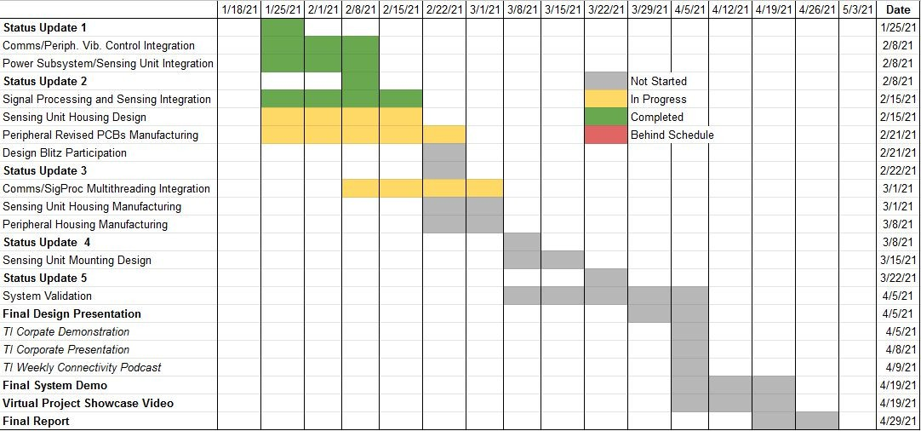
Integration/Execution Timeline

Slide 2
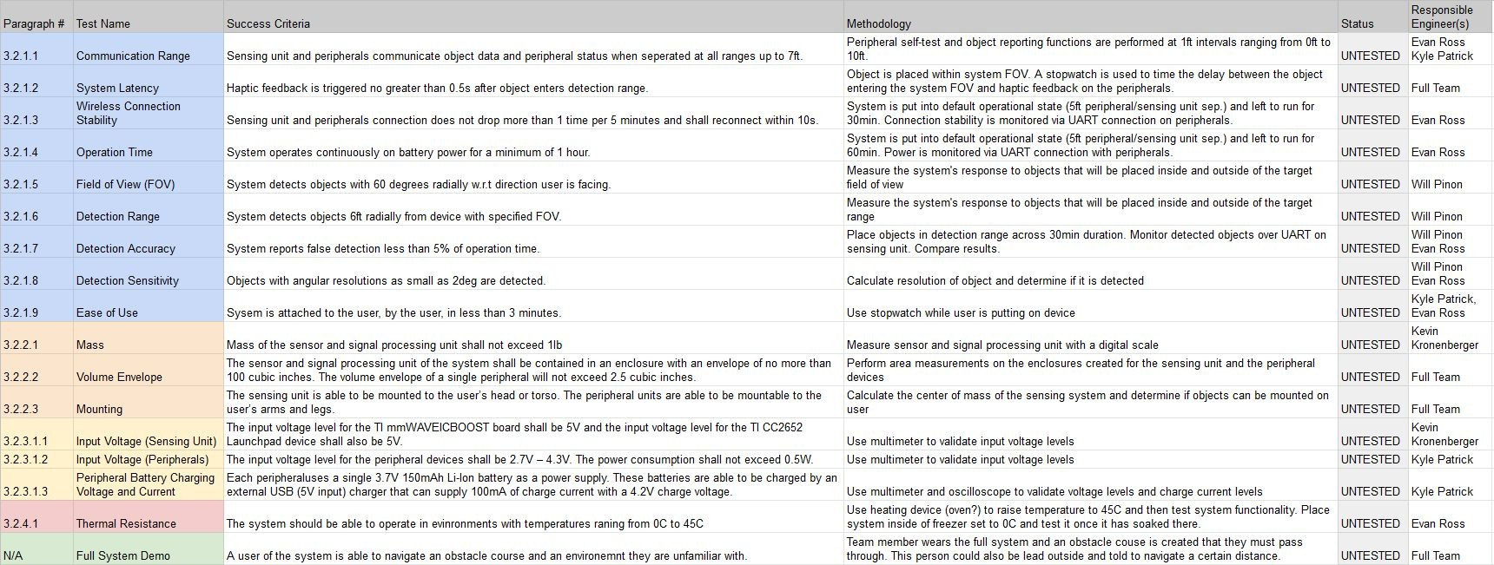
Validation Plan

